Slide 1

Mathematical models of human biology in BioModels
Species | Curated (1063) | Non-curated (1393)
Human | 416 | 394
Mus | 80 | 53
Saccharomyces | 62 | 83
Escherichia | 30 | 21
Others/n.a. | 475 | 842
Type | Curated (1063) | Non-curated (1393)
ODE | 479 | 616
Constraint-based | 4 | 246
Logical | 4 | 28
Others/n.a. | 576 | 503

Slide 2

Mathematical models originate from various frameworks
…
Roadmap
Previous TCM/JSC
Next TCM
…
Current TCM
Next TCM
Next JSC

Slide 3
Problem: limited usability of open disease models
Limited coverage of diseases
Fragmented modelling frameworks (MATLAB, python, R, SBML)
Limited reproducibility
Missing annotations

Slide 4
The solution: unify disease models in controlled, ML-compatible format
1. Re-code the published model in community standard format
SBML to enable broader use by the research community

Slide 5


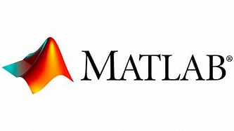


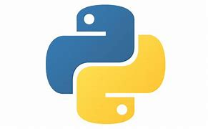
The solution: unify disease models in controlled, ML-compatible format
1. Re-code the published model in community standard format
SBML to enable broader use by the research community

Slide 6

The solution: unify disease models in controlled, ML-compatible format
1. Re-code the published model in community standard format
SBML to enable broader use by the research community
Standardisation
Automation

Slide 7
The solution: unify disease models in controlled, ML-compatible format
1. Re-code the published model in community standard format
SBML to enable broader use by the research community
2. Re-produce published simulations and analyses
Using open-source tools; triage the models as necessary

Slide 8
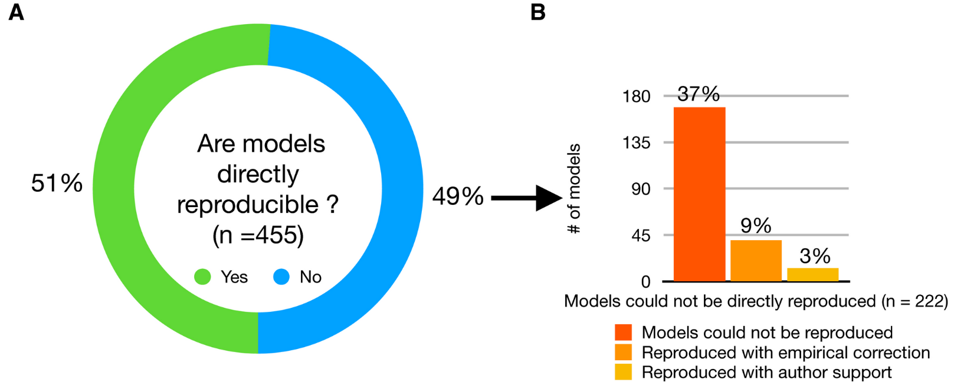
The solution: unify disease models in controlled, ML-compatible format
2. Re-produce published simulations and analyses
Using open-source tools; triage the models as necessary

Slide 9
The solution: unify disease models in controlled, ML-compatible format
1. Re-code the published model in community standard format
SBML to enable broader use by the research community
2. Re-produce published simulations and analyses
Using open-source tools; triage the models as necessary
3. Re-annotate the model with established ontologies
EBI-EMBL ontologies to enable cross-linking between databases

Slide 10
The solution: unify disease models in controlled, ML-compatible format
3. Re-annotate the model with established ontologies
EBI-EMBL ontologies to enable cross-linking between databases (e.g. UniProt, Cell Ontology)
Increased understanding of the model components
Interoperability with other information resources, e.g., omics data

Slide 11
The solution: unify disease models in controlled, ML-compatible format
1. Re-code the published model in community standard format
SBML to enable broader use by the research community
2. Re-produce published simulations and analyses
Using open-source tools; triage the models as necessary
3. Re-annotate the model with established ontologies
EBI-EMBL ontologies to enable cross-linking between databases

Slide 12




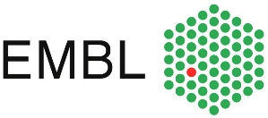

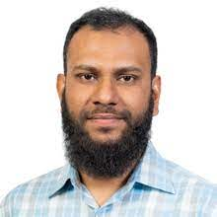
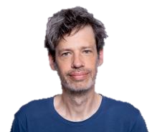

The solution: hackathon to expand disease coverage
Team VPE
Rahuman Sheriff Malik Sheriff
Senior Project Leader
Sven Sahle Group Leader, lecturer
Daniela Beyer Program manager
August 28th to 29th 2024

Slide 13
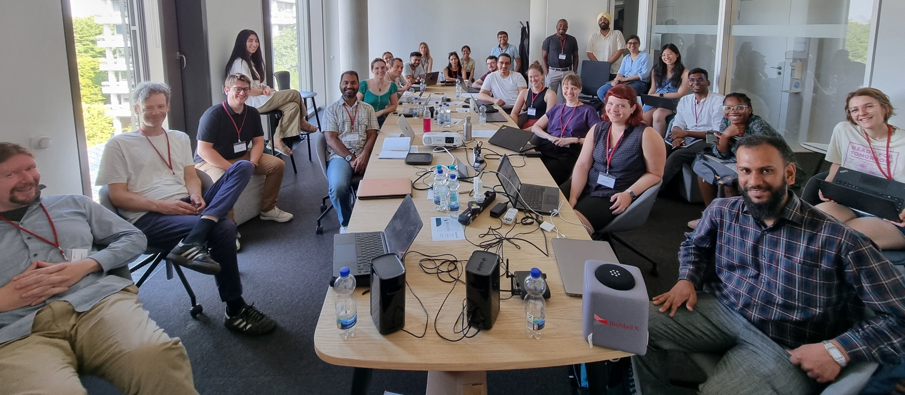
Hackathon on August 28th to 29th 2024
🎖️ 7 teams (22 participants) on-site, and 3 teams (12 participants) on-line.
🎖️ Diverse team compositions of biologists, data scientists, and computational modelers.
🎖️ 11 mathematical models were hacked: 2 models were completely curated and 2 models were recoded and reproduced.

